Slide 1



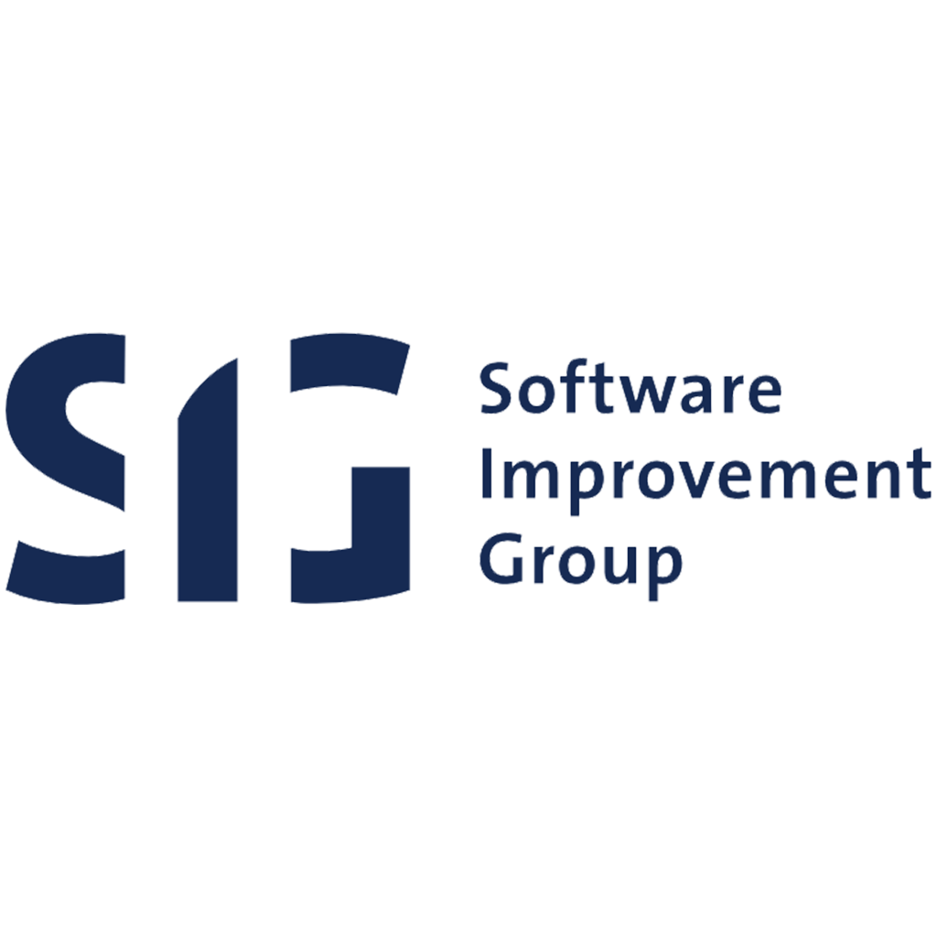





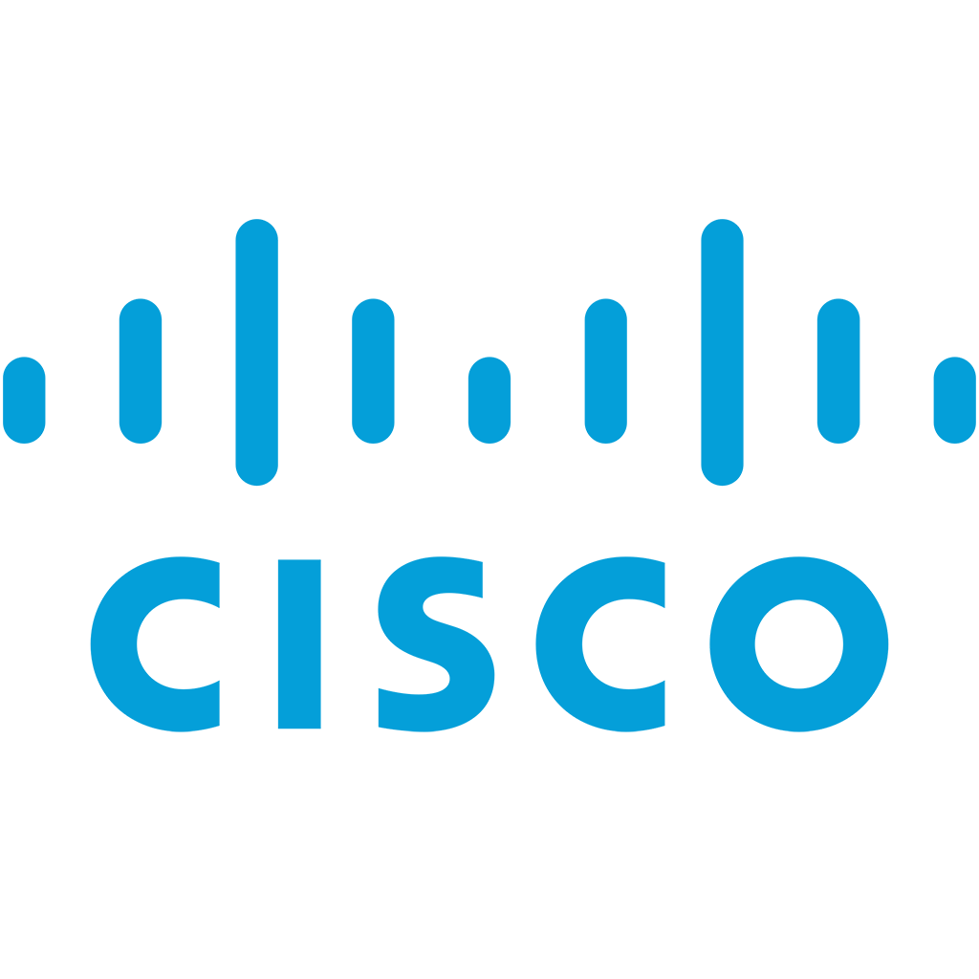

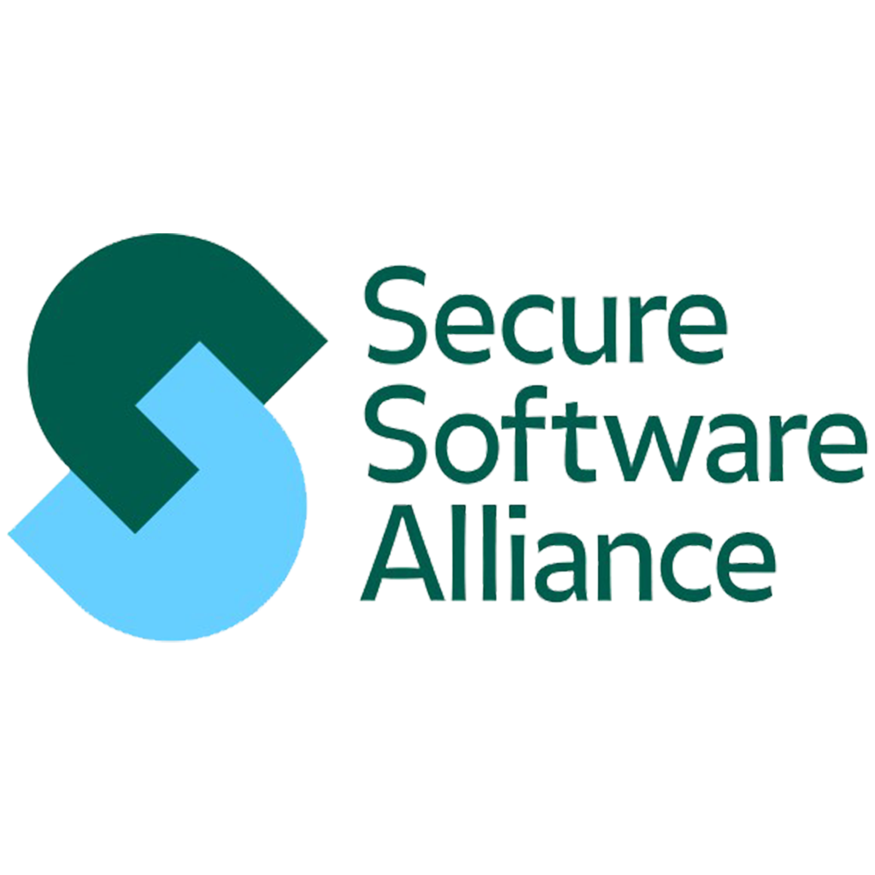

TrustSECO: A Trust Infrastructure for a Resillient Worldwide Software Ecosystem
Dr. slinger jansen
Drs. Fang Hou
drs. Siamak Farshidi
Donny Groeneveld
Floris Jansen
Venja Beck
Jozef Siu

Slide 2

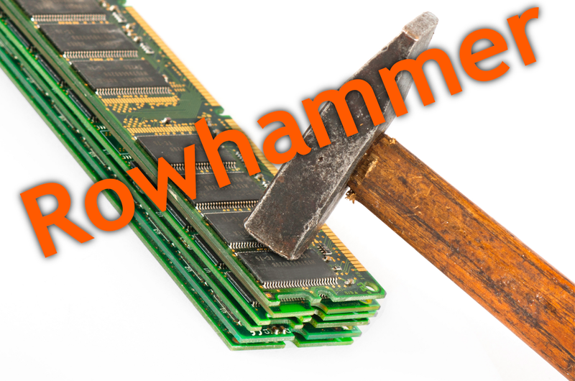


The Problem
Software systems are collections of interdependent components that are produced in an ecosystem of software producing organizations.
The worldwide software software ecosystem is a trust-rich environment.
It is a miracle that we are not experiencing more attacks and finding more vulnerabilities.
The card house is going to collapse if we don’t act fast.

Slide 3
The Proposed Solution: TrustSECO
We want to guarantee that the code that is on the system, was the same as it was intended by the original producer of the code.
Furthermore, we want to make the worldwide software ecosystem anti-fragile by:
making nodes self-healing,
Making all software ecosystem participants responsible,
Using a rhizome-inspired warning system.

Slide 4
TrustSECO: The Implementation
We store software lifecycle data in a distributed database that can only be appended to through consensus
The database is maintained by members of the community (and possibly even customers)
System maintainers (DevOps) can ask for particular trust levels when installing a system
Install Mozilla with at least Trust Level 10
Install Python 2.7 with at least Trust Level 0
Who wrote the code? Was it tested properly? Who built the code? Who released the code? Who touched the code? How long ago? Is the project active? Who else has this team worked with? On how many systems is this code being used? Which system is the system dependent on? Can the code reproducibly be built? Etc.

Slide 5
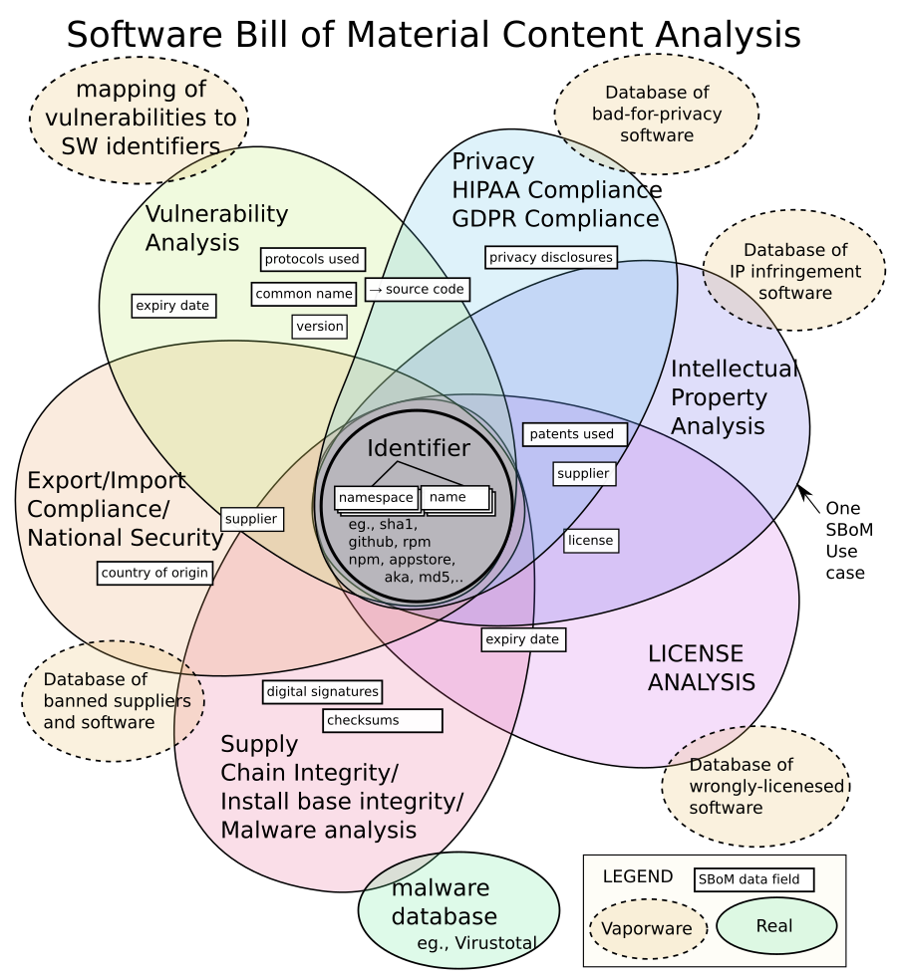
Use Cases
Ministry of Defense wants to update its servers; servers can only host software at trust level 10. TrustSECO finds the possible configurations and installs them.
A system at Gemeente Den Haag is found to be at a too low trust level. TrustSECO automatically upgrades to a version with a higher trust level.
Centric guarantees Gemeente Den Haag that its systems have only been touched by Dutch and Romanian software developers. TrustSECO generates the SBOM and annotates it with trust data.

Slide 6
TrustSECO Project Status
Research projects currently under evaluation with NWO, NLnet.
TrustSECO prototype under construction, presentation at Odyssey Hackathon, in two weeks
TrustSECO score calculation projects underway:
How should scores be calculated? (Floris, Venja, Donny, Fang)
Which data affects which scores? (Fang, Floris, Venja, Slinger, Donny)
What impact factors can be identified? (Fang, Floris, Venja, Slinger, Donny)
What do developers think of the scores? (Floris, Fang)
SBOM is an asset, not a competitor

Slide 7
